Slide 1
Travel well
made BY
장지은(YC)
20185079

Slide 2
INDEX
-
개요
-
화면 구성
-
파일 구성
-
코드 설명
-
결과
-

Slide 3
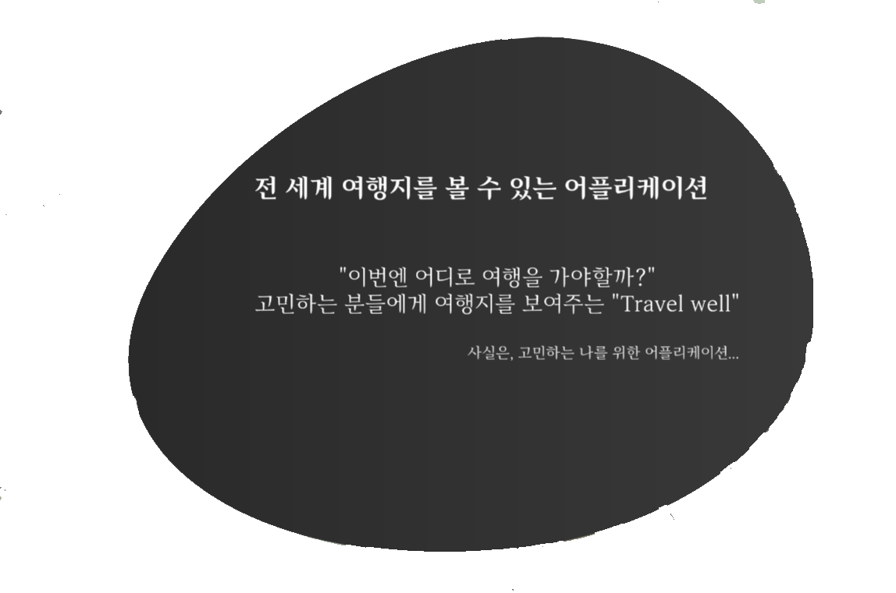
개요
Travel Well
Madeby 장지은
2019, Android pRoject

Slide 4
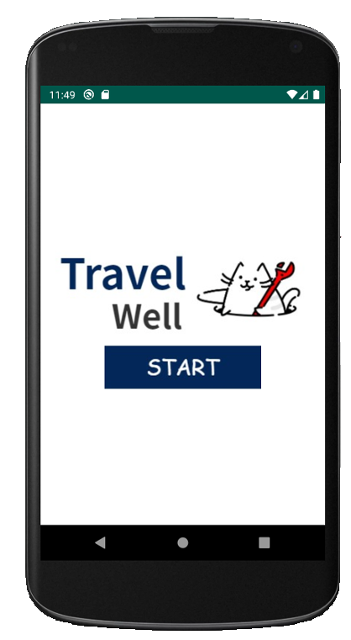
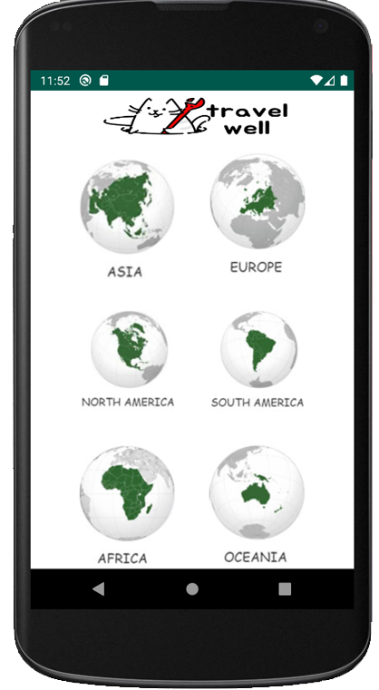
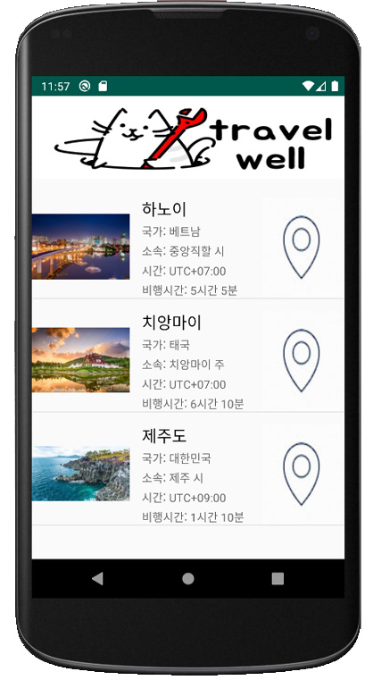
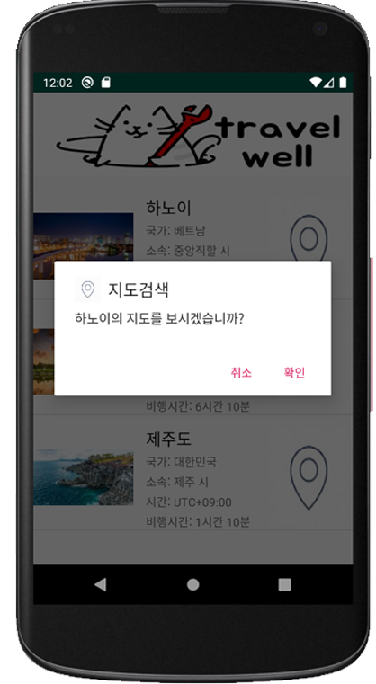
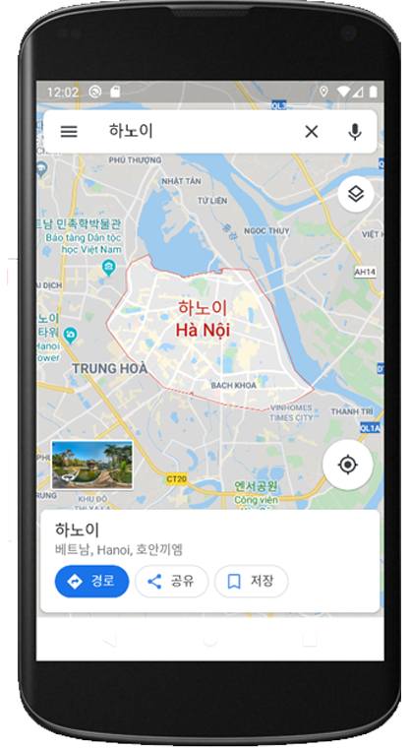
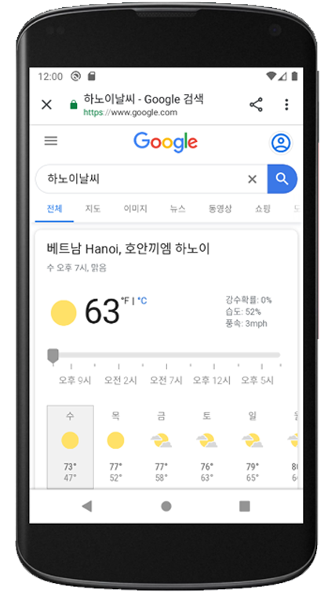
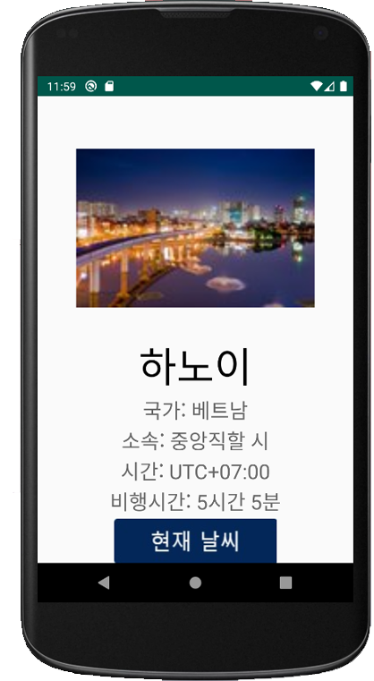
화면구성
Travel Well
Madeby 장지은
2019, Android pRoject

Slide 5
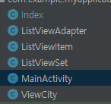
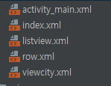
파일구성
Travel Well
Madeby 장지은
JAVA
LAYOUT
2019, Android pRoject

Slide 6
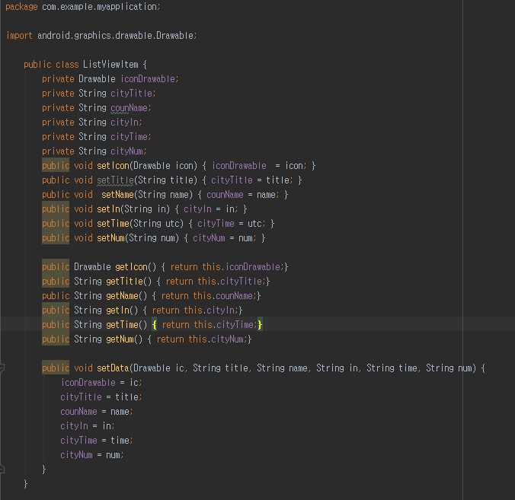
ListViewItem.class
Travel Well
Madeby 장지은
2019, Android pRoject

Slide 7

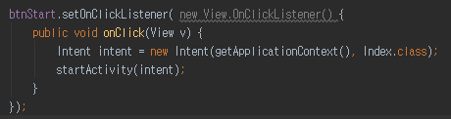
MainActivity.class & activity_main.xml
Travel Well
Madeby 장지은
2019, Android pRoject

Slide 8
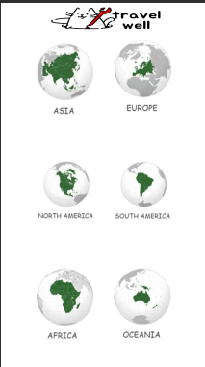
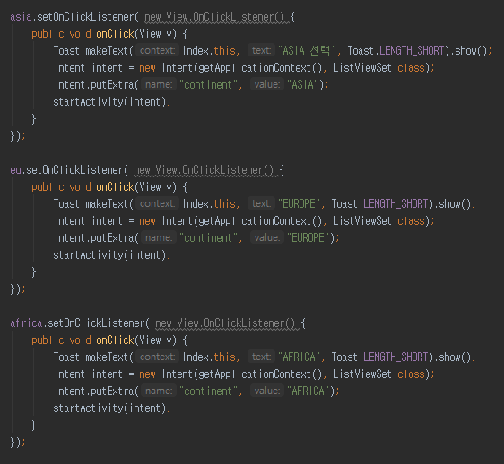
index.xml & Index.class
Travel Well
Madeby 장지은
2019, Android pRoject

Slide 9

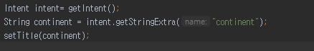
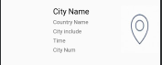
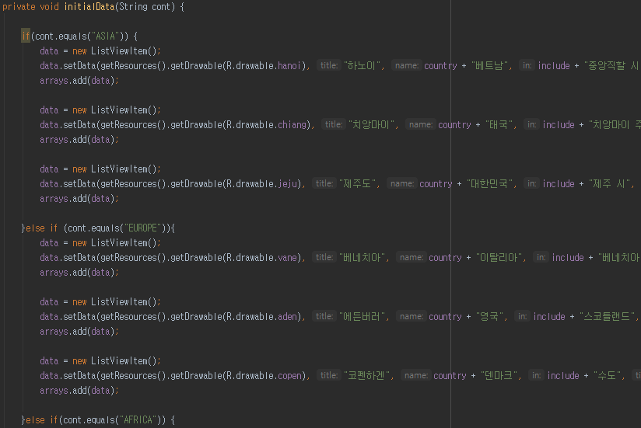
listView.xml & row.xml & ListViewSet.java
Travel Well
Madeby 장지은
2019, Android pRoject

Slide 10
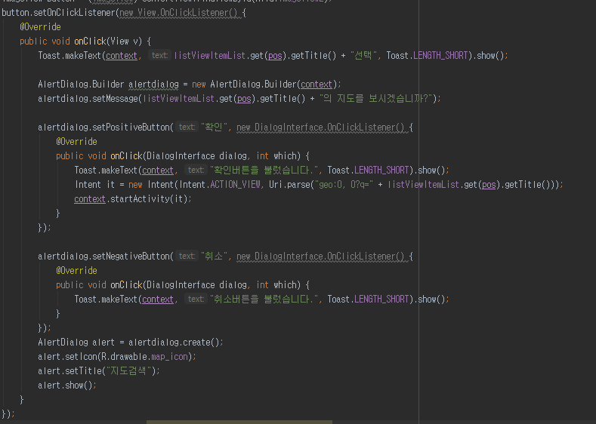
ListViewAdapter.java
Travel Well
Madeby 장지은
2019, Android pRoject

Slide 11
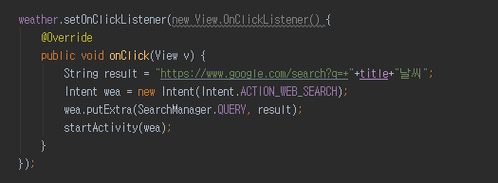
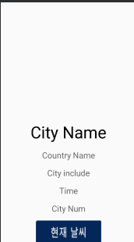
viewcity.xml & ViewCity.java
Travel Well
Madeby 장지은
2019, Android pRoject

Slide 12
결과
Travel Well
Madeby 장지은
2019, Android pRoject

Slide 13
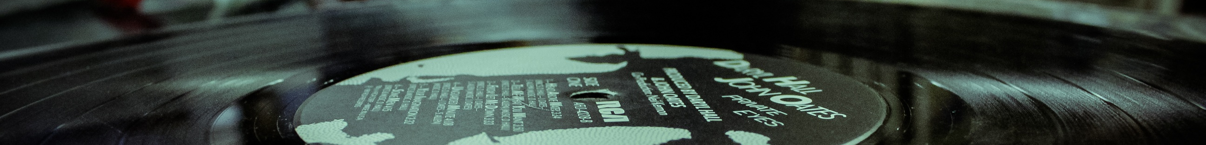
Travel Well
Made by 장지은
감사합니다
Thank you

